Slide 1
PostgreSQL Installation
A quick guide

Slide 2
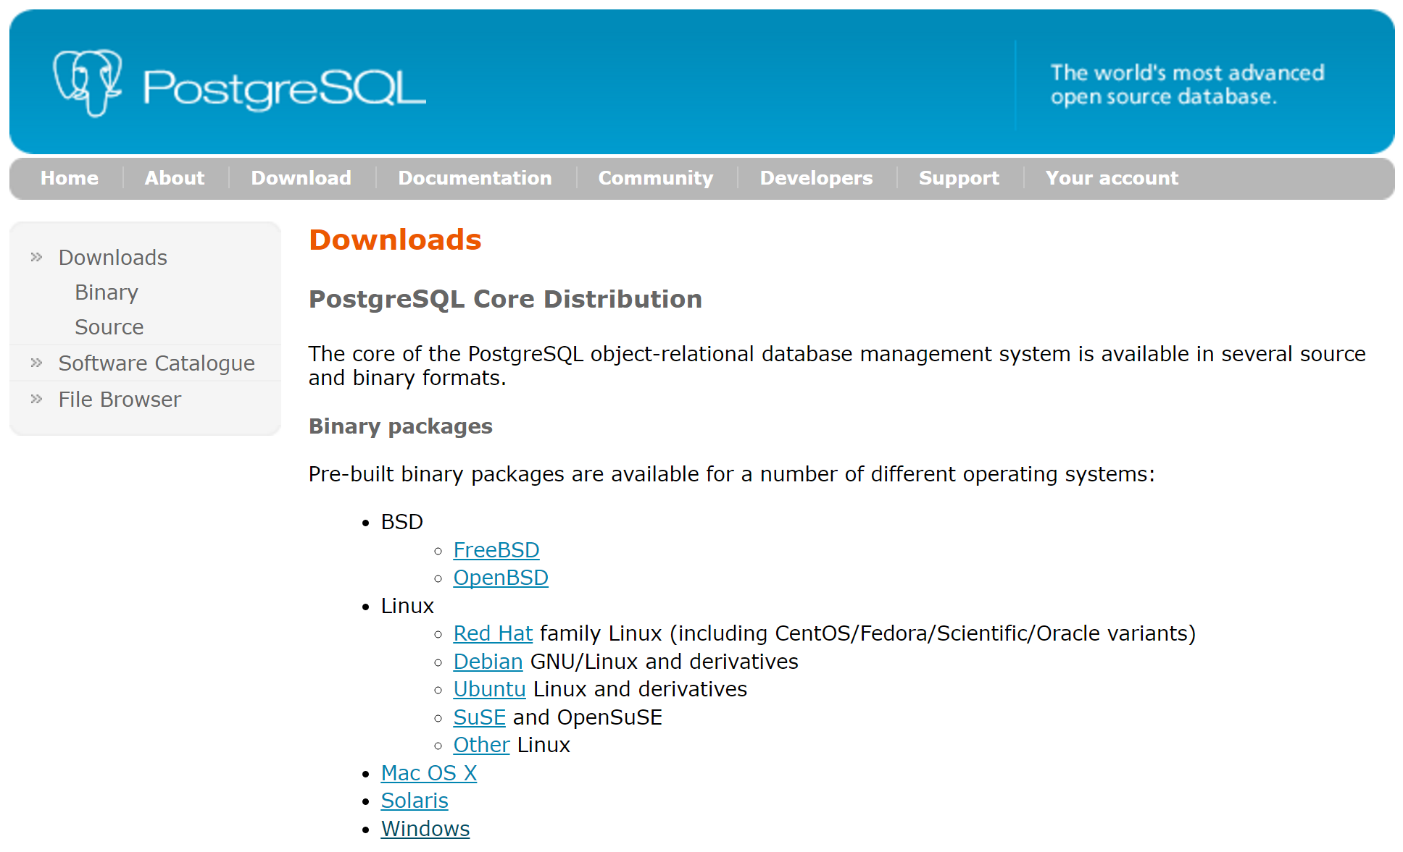
Grab the installer

Slide 3
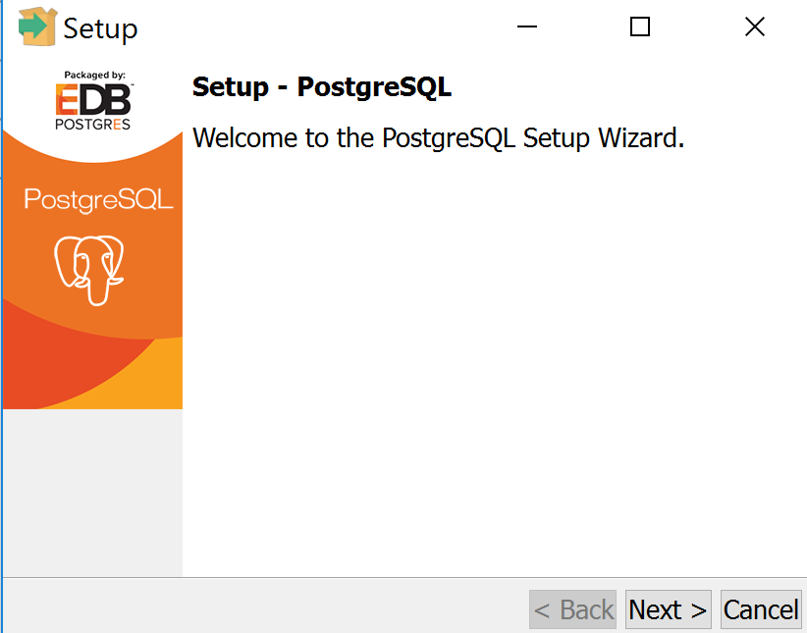
Click Next a bunch of times to install

Slide 4
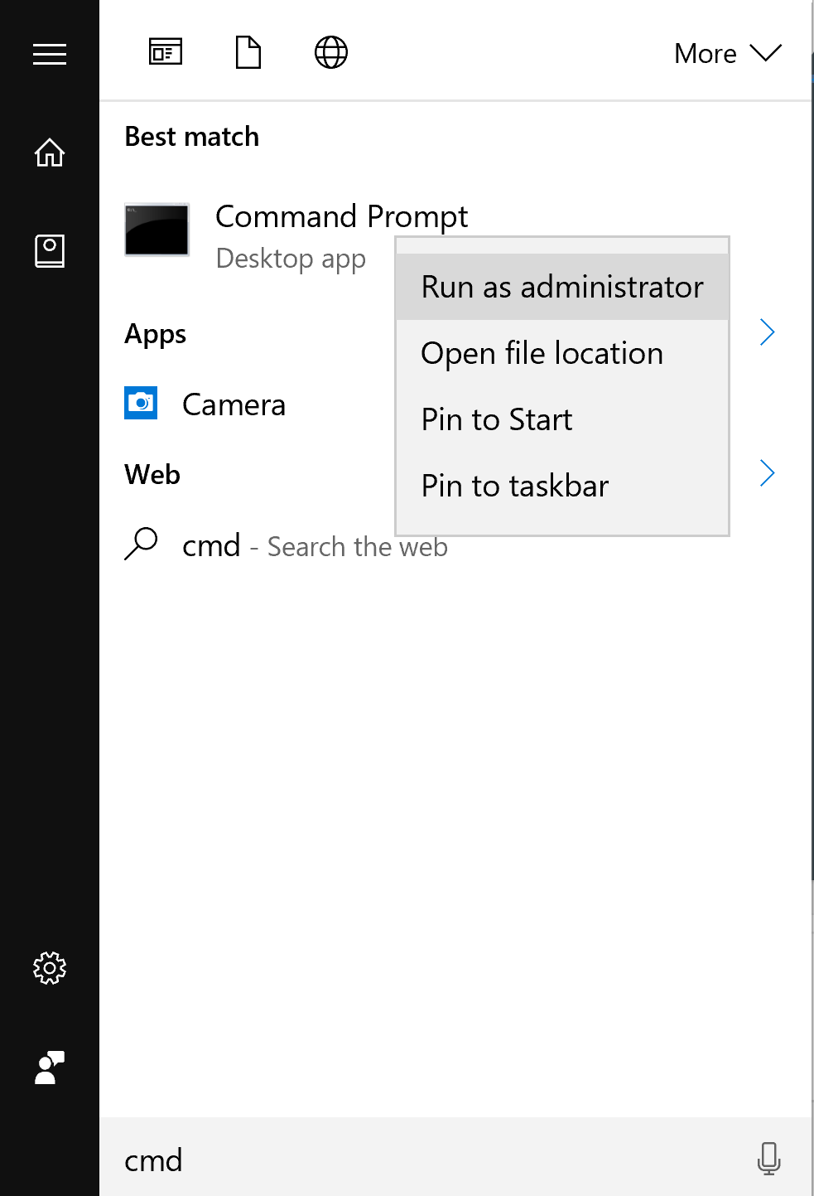
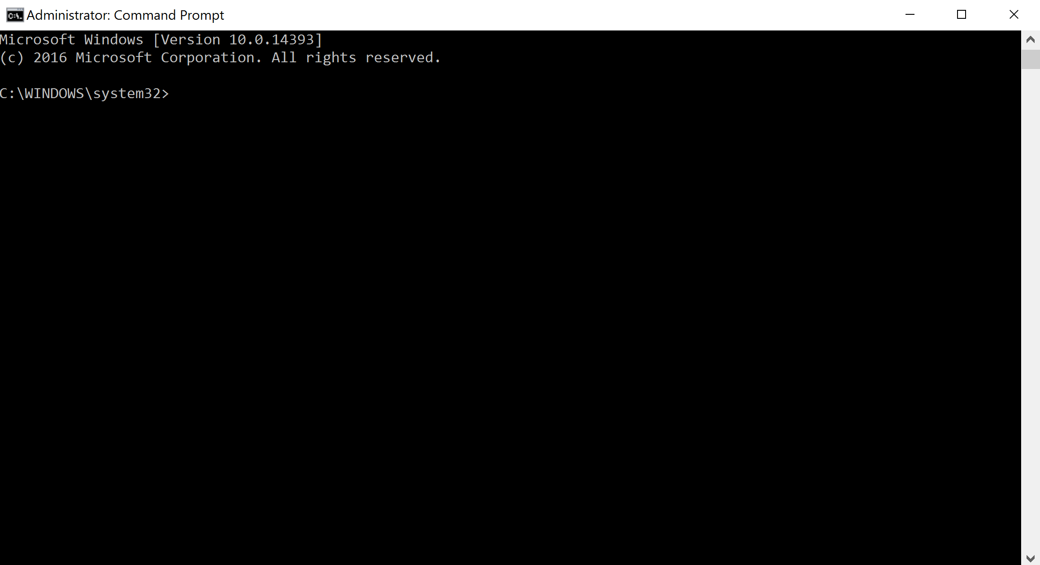
Open up 2 administrator command prompts

Slide 5
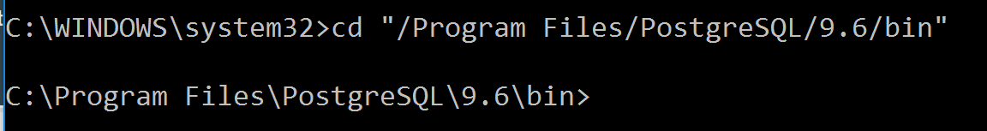
Navigate both to “/Program Files/PostgreSQL/9.6/bin"

Slide 6
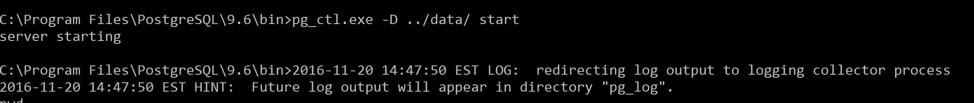
Start the server “pg_ctl.exe -D ../data/ start”

Slide 7
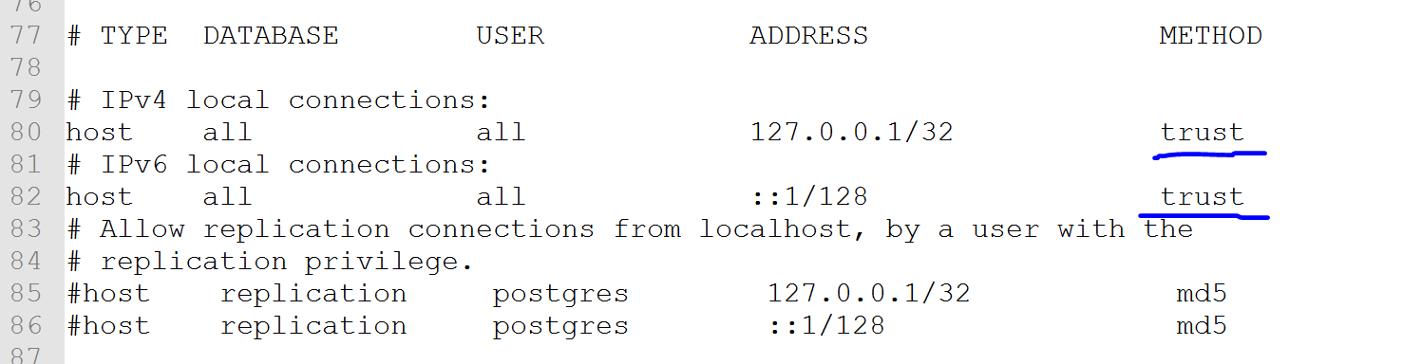
Edit “/Program Files/PostgreSQL/9.6/data/pg_hba.conf”

Slide 8
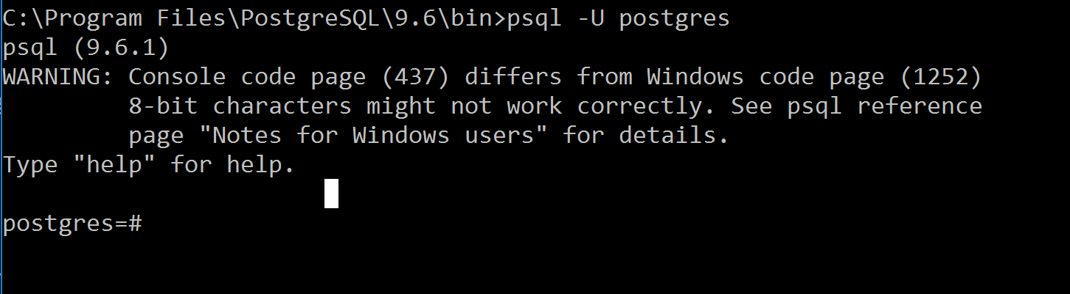
In the second terminal, “psql -U postgres”

Slide 9
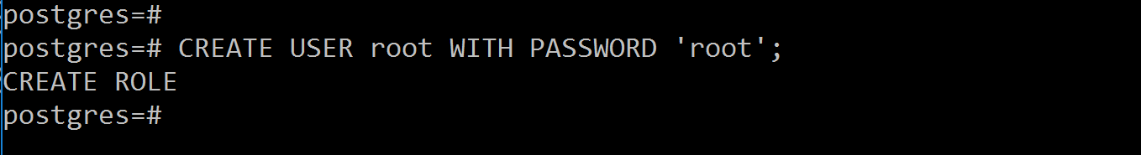
Add the root user

Slide 10

Now, the lab begins…
Good luck!

